Slide 2
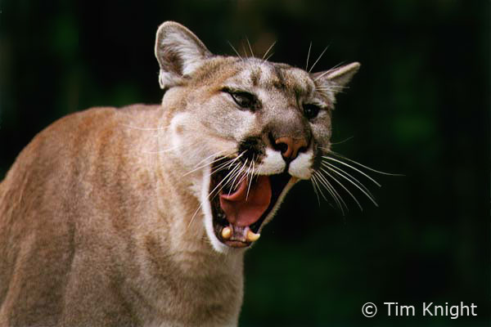
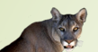

C
P
T
Cougar Peek
Cougar Peek Transactions

Slide 3
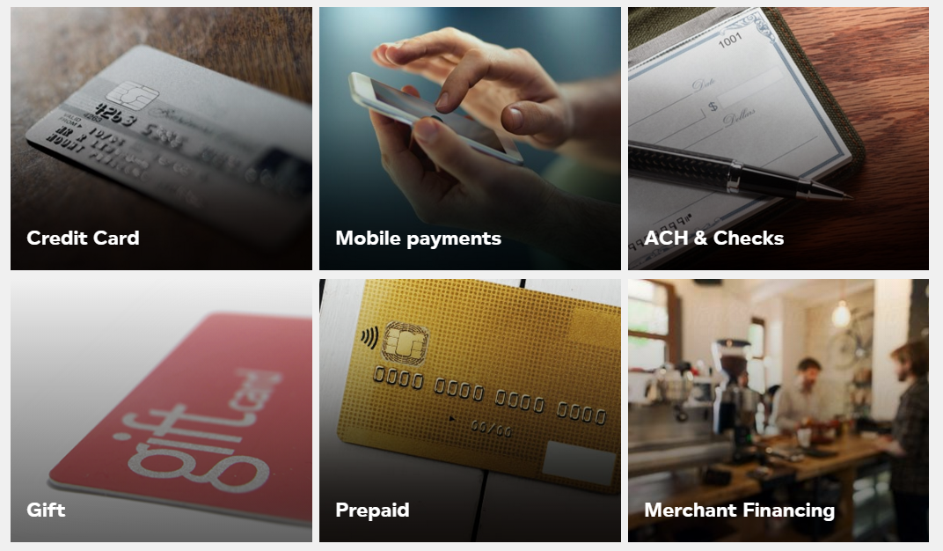
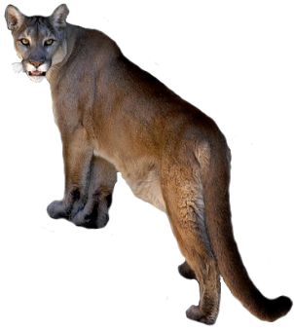
What we do
Cougar Peek

Slide 4
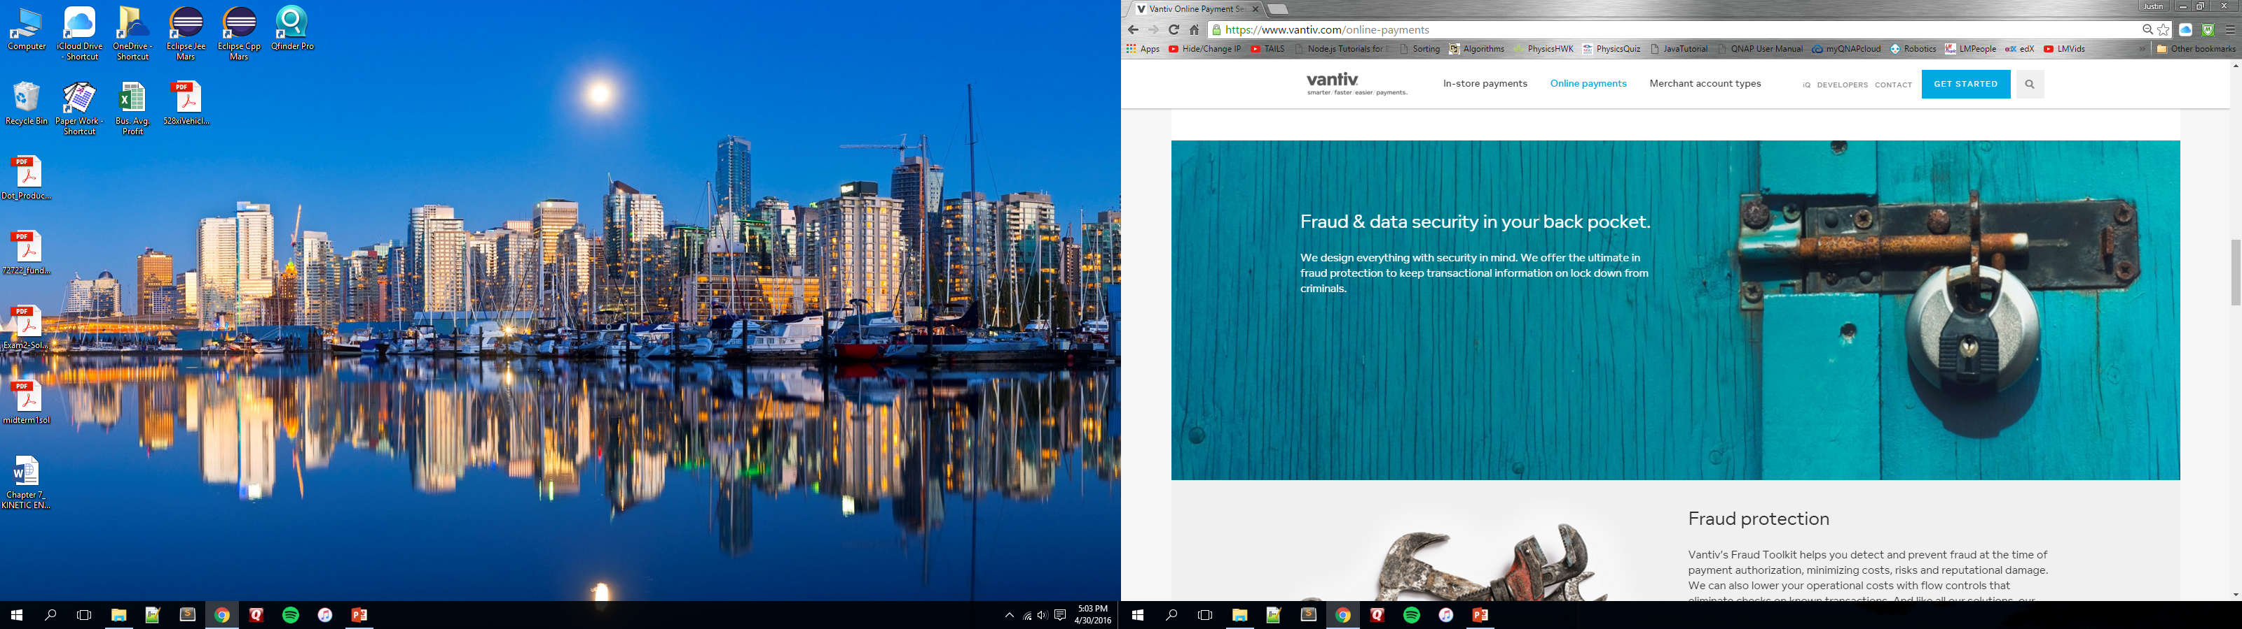
Lock it Up
Cougar Peek

Slide 5
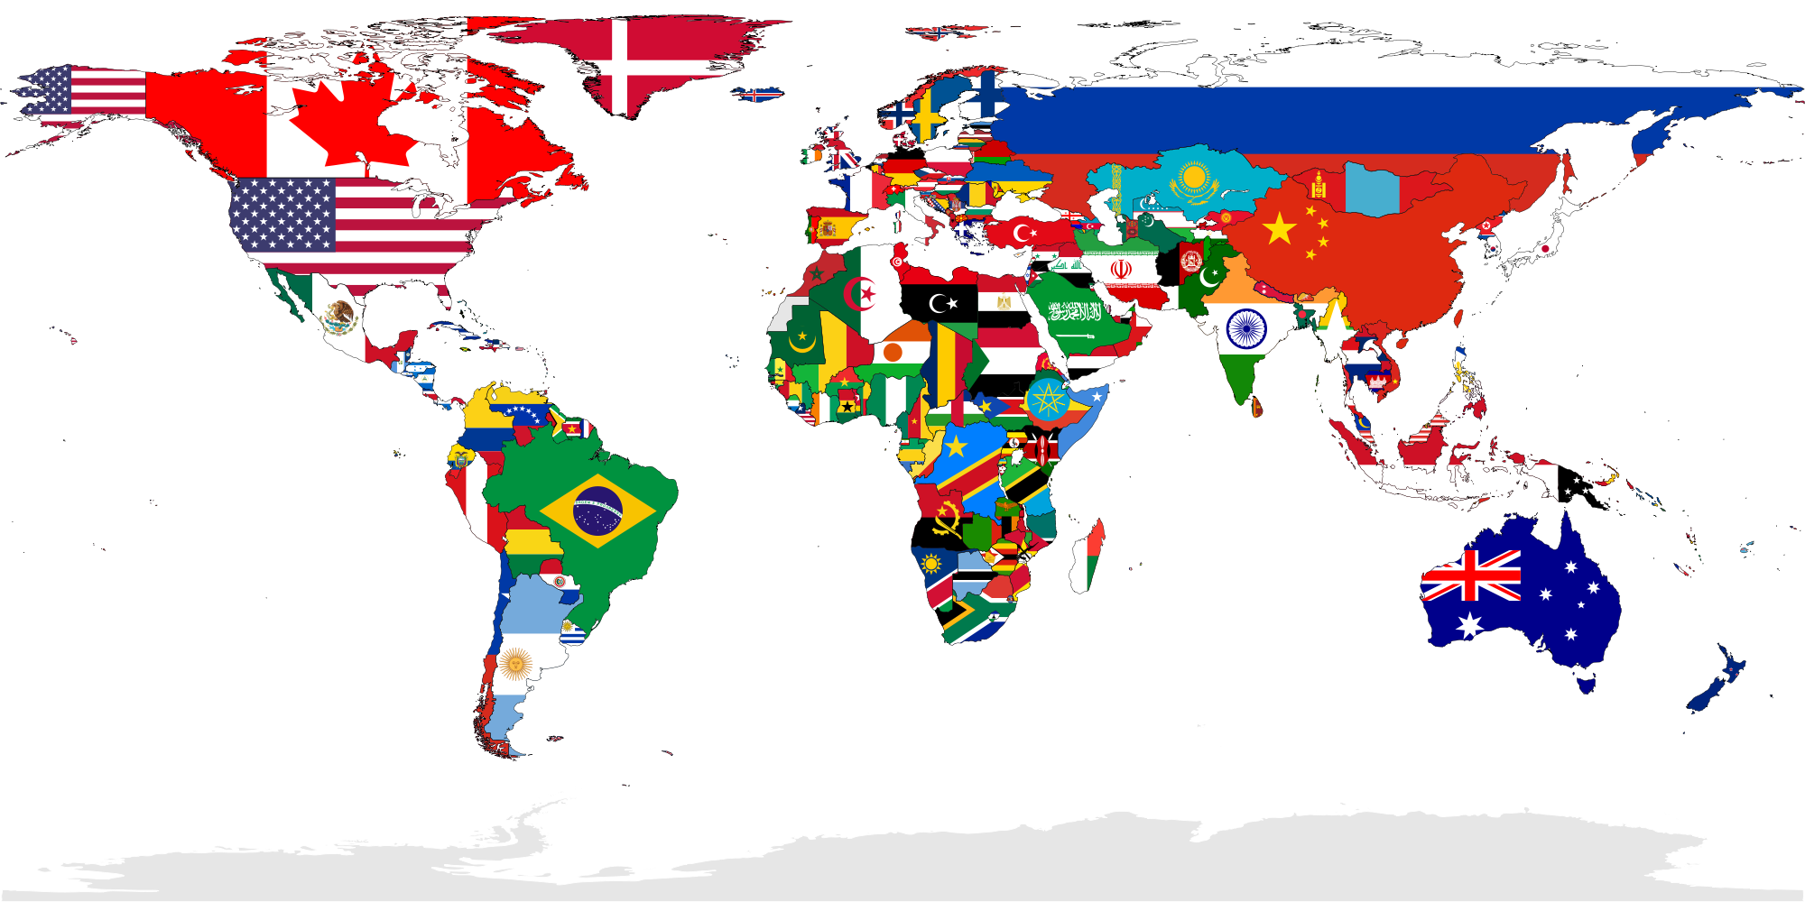
Mission Accomplished
Who are you?
I don’t know you
Cougar Peek

Slide 6
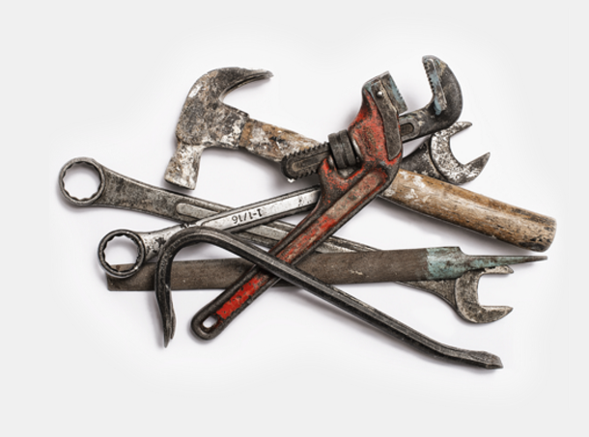
Built for customers
Cougar Peek
We peek on transactions so you don’t have to
By customers

Slide 7
Live Demo
Cougar Peek

